Slide 1
CSC 112: Computer Operating Systems Lecture 8 Memory System II: Paging
Department of Computer Science,
Hofstra University

Slide 2
Outline
Paging
Page Translation
Page Table
Table Lookaside Buffer (TLB)
Multi-level paging
Page Swapping
Page Replacement

Slide 3
Typical Memory Hierarchy
Managed in Hardware
Managed in Software - OS
?
Processor
Secondary Storage (Disk)
TLB
PT
L2 Cache
Registers
L1 Cache
Secondary Storage (SSD)
PT
PT
Main
Memory
(DRAM)
PT
TLB
L3 Cache (shared)
L2 Cache
Registers
L1 Cache
Accessed in Hardware
Speed (ns):
0.3
1
3
10-30
100
100,000 (0.1 ms)
10,000,000
(10 ms)
Size (bytes):
100Bs
10kBs
100kBs
MBs
GBs
100GBs
TBs

Slide 4
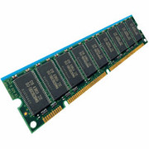
Two Views of Memory
CPU
Virtual
Addresses
Physical
Addresses
MMU
Untranslated read or write
Two views of memory:
View from the CPU (what program sees, virtual memory)
View from memory (physical memory)
Memory management unit (MMU) converts between the two views
Kernel accesses physical memory directly without translation
Translation helps to implement protection
The same virtual address in different processes is mapped to different physical addresses, hence different processes cannot read/write each other’s memory
Every program can be linked/loaded into same region of user address space
Isolation achieved through translation, not relocation

Slide 5
Paging
Divide physical memory into fixed-sized blocks, called physical page frames (or simply frames)
Divide virtual memory into blocks of the same size called virtual pages (or simply pages)
Set up a page table to map from pages to frames
Need both OS and hardware support (MMU)
Stack
Heap
Data
Code
Heap 2
Stack
Heap
Data
Code
Code1
Data 1
Stack 1
Code 2
Proc 1
Virtual
Address
Space 1
Heap 1
Proc 2
Virtual
Address
Space 2
Data 2
Stack 2
OS code
Translation Map 1
(Page Table)
OS data
Translation Map 2
(Page Table)
OS heap &
Stacks
Physical Address Space
Notes:
Keep track of all free frames
No external fragmentation, but internal fragmentation

Slide 6
Paging Example
Suppose page size is 4 KB, and the virtual address space has 8 pages
Page table maps from Virtual Page Number (VPN) to Physical Page Number (PPN)
PPN also called Page Frame Number (PFN).
Some VPNs (5, 6) are not mapped to PPN, and accessing them will cause a page fault to go to disk and fetch the page into memory.
0
0
1
0
Virtual Address Space
consists of 8 x 4K Byte pages, or
16768 Bytes
1
2
2
2
3
3
1
4
4
Physical Memory
5
5
6
6
7
3
7
Page Table
(contains
VPN => PPN
mapping)
4
Virtual Address Space
7
Page table makes it possible to store the pages of a process non-contiguously in physical memory.
Notes:
as they are unused,
process is mapped to physical memory Assume 6-bit memory address, with virtual address space size 2^6=64 Bytes. Assume page size is 16 bytes, and the virtual process address space consists of 4 pages.
Figure shows one example virtual-to-physical page mapping
VPN also called Page Number p;
Paging allows the physical address space of a process to be non-contiguous

Slide 7
Steps in Handling Page Faults
Process
virtual address
physical address
MMU
page#
PT
instruction
frame#
retry
page fault
offset
exception
frame#
Operating System
offset
update PT entry
Page Fault Handler
load page from disk
scheduler

Slide 8
Paging Benefits
Flexibility: Supporting the abstraction of address space effectively
Don’t need assumption how heap and stack grow and are used.
Simplicity: ease of free-space management
The page in virtual address space and the physical page frame are the same size.
Easy to allocate and keep a free list

Slide 9
Page Translation
A virtual address is split into two parts
Virtual page number (or Page number ) – used as an index into a page table which contains base address of each page in physical memory
High bits to indicate page number
Offset – combined with base address to define the physical memory address within the page
Low bits to indicate offset
Given virtual address space 2^{m} and page size 2^{n} Bytes, n bits for offset and m-n bits for page number
Only need to translate the page number to determine where the physical page is
Page offset determines page size, which is the same for both virtual and physical memory
Page offset refers to byte address within a memory page (e.g., 4KB); compare with byte offset in caching, which refers to byte address within a cache/memory block (e.g., 8 Bytes)
Page #
Offset
m-n
n
Notes:
Similar to segmentation, high bits for page number and low bits for offset that is sent to the memory unit

Slide 10
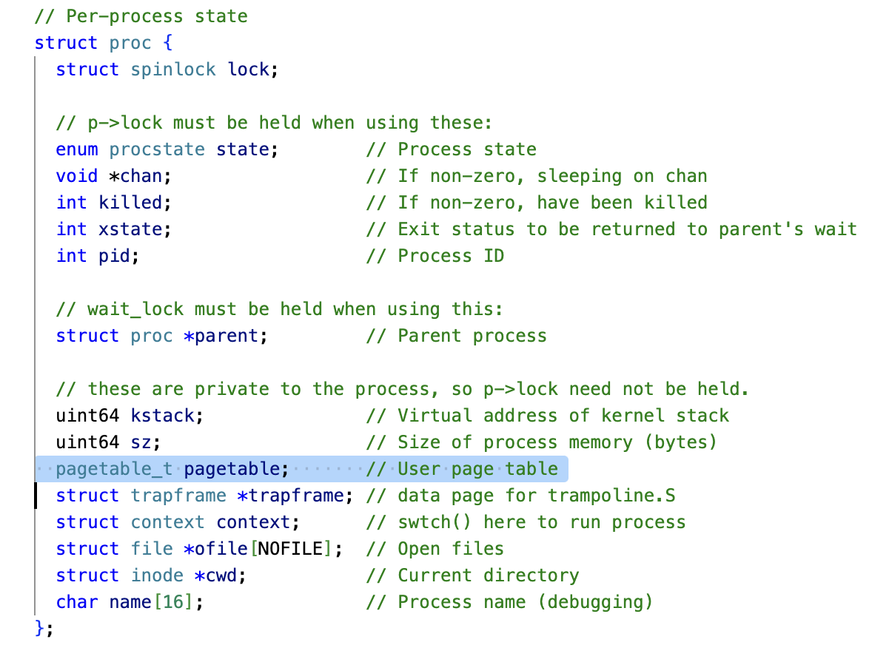
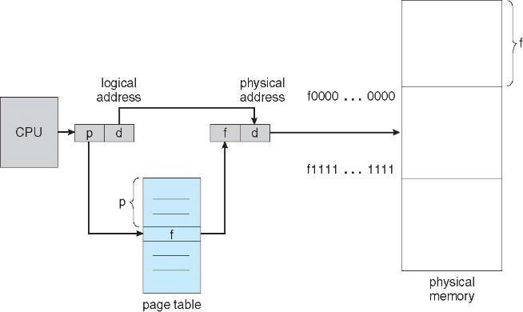
Page Table
Page table
Keeps track mapping of virtual to physical addresses
Part of Process Control Block (PCB) for each process, kept in main memory
Notes:
you can see this in xv6

Slide 11
Page Translation Mechanism
Generally, VPN has more bits than PPN, since physical memory is smaller (# virtual pages ≥ # physical page)
Virtual Address
Virtual Page Number
Page Offset
VPN
Offset
Virtual
Address
1
0
1
0
1
0
1
valid
Physical Page Number
Page Table
Address Translation
page
table
Physical
Address
1
1
0
1
0
1
PPN
offset
Physical Address
Physical Page Number
Page Offset
Notes:
The steps of each memory reference
Extract virtual page number from virtual address (memory access)
Calculate address of page table entry
Fetch page table address
Extract physical page frame number
Determine physical address
Fetch physical address to register (memory access)

Slide 12
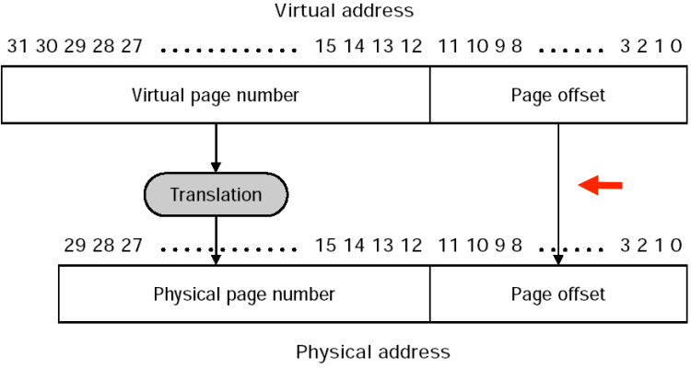
Page Translation Example
Virtual Address: 32 bits, virtual address space 2^32=4GB
Physical Address: 29 bits, physical address space 2^29=0.5GB
Page size: 2^12=4KB, hence offset is 12 bits
VPN has 32-12=20 bits, PPN has 29-12=17 bits
20 bits
12 bits
17 bits
12 bits
Notes:
32-bit virtual address, virtual address space 2^32=4GB
Physical memory 2GB
Page size 2^12=4KB, hence offset is 12 bits.
Number of physocal memory pages is 2GB/4KB=2^19, hence page number is 19 bits

Slide 13
Separate Address Space per Process
Proc 1
OS
pages
VA1
Page Table
Proc 2
VA1
Page Table
Physical Memory
Proc 3
VA1
Page Table
free
Each process has own page table.
Same Virtual Address (VA1) is mapped to different physical addresses, so different processes cannot read/write each other’s memory
Notes:
which contains an entry for each program page

Slide 14
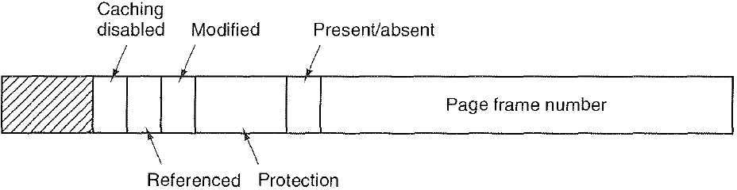
Page Table Entry (PTE)
A PTE contains:
Physical Page Number (PPN), also called Page Frame Number
Present/absent bit, also called Valid bit. If this bit is 1, the page is in memory and can be used. If it is 0, the page is not currently in memory. Accessing a page table entry with this bit set to 0 causes a page fault to get page from disk.
Protection bits tell what kinds of access are permitted on the page. 3 bits, one bit each for enabling read, write, and execute.
Modified (M) bit, also called dirty bit, is set to 1 when a page is written to
Referenced (R) bit, is set whenever a page is referenced, either for reading or writing.
M and R bits are useful to page replacement algorithms
Caching disabled bit, important for pages that map onto device registers rather than memory
(Physical)
Other possible bits
Notes:
The page table data structure is kept in main memory
Page-table base register indicates the starting address of page table
The simplest form of a page table is a linear page table, an array data structure
Page Table Entry (PTE) includes:
Page translation information: Page Frame Number (PFN)
Other information: P: present bit; R/W: read/write bit; U/S: user/supervisor bit; A: accessed bit; D: dirty bit

Slide 15
Paging example: initial state
~ FFFF FFFF_{hex}
stack
~ FFFF FFFF_{hex}
stack
7
6
5
4
3
2
1
0
7
6
5
4
3
2
1
0
heap
heap
static data
static data
code
Page Table
Page Table
code
~ 0_{hex}
~ 0_{hex}
Process 1
Virtual Memory
Process 2
Virtual Memory
Physical Memory

Slide 16
Paging example: Process 1 starts to run
~ FFFF FFFF_{hex}
stack
~ FFFF FFFF_{hex}
stack
7
6
5
4
3
2
1
0
7
6
5
4
3
2
1
0
heap
heap
static data
static data
code
Page Table
Page Table
code
~ 0_{hex}
Stack 1
~ 0_{hex}
Process 1
Virtual Memory
Heap 1
Process 2
Virtual Memory
Static 1
Code 1
Physical Memory

Slide 17
Paging example: Process 2 starts to run
~ FFFF FFFF_{hex}
stack
~ FFFF FFFF_{hex}
stack
7
6
5
4
3
2
1
0
7
6
5
4
3
2
1
0
heap
Stack 2
heap
static data
Heap 2
static data
Static 2
code
Page Table
Code 2
Page Table
code
~ 0_{hex}
Stack 1
~ 0_{hex}
Process 1
Virtual Memory
Heap 1
Process 2
Virtual Memory
Static 1
Code 1
Physical Memory

Slide 18
Paging example: Process 1 dynamic memory allocation on its heap with malloc()
~ FFFF FFFF_{hex}
stack
~ FFFF FFFF_{hex}
stack
7
6
5
4
3
2
1
0
7
6
5
4
3
2
1
0
Heap’ 1
heap
Stack 2
heap
static data
Heap 2
static data
Static 2
code
Page Table
Code 2
Page Table
code
~ 0_{hex}
Stack 1
~ 0_{hex}
Process 1
Virtual Memory
Heap 1
Process 2
Virtual Memory
Static 1
Code 1
malloc(4097)
Physical Memory

Slide 19
Paging example: Process 2 dynamic memory allocation on its stack with Recursive function call
~ FFFF FFFF_{hex}
stack
~ FFFF FFFF_{hex}
stack
7
6
5
4
3
2
1
0
7
6
5
4
3
2
1
0
Stack’ 2
Heap’ 1
heap
Stack 2
heap
static data
Heap 2
static data
Static 2
code
Page Table
Code 2
Page Table
code
~ 0_{hex}
Stack 1
~ 0_{hex}
Process 1
Virtual Memory
Heap 1
Process 2
Virtual Memory
Static 1
Code 1
malloc(4097)
Physical Memory
Recursive function call

Slide 20
Paging example: controlled sharing of Code (Instruction) page
~ FFFF FFFF_{hex}
stack
~ FFFF FFFF_{hex}
stack
7
6
5
4
3
2
1
0
7
6
5
4
3
2
1
0
heap
heap
static data
Stack 2
static data
Heap 2
code
Page Table
Static 2
Page Table
code
~ 0_{hex}
Stack 1
~ 0_{hex}
Process 1
Virtual Memory
Heap 1
Process 2
Virtual Memory
Static 1
Code
Physical Memory
Shared Code Page
“X” Protection Bit

Slide 21
Code Page Sharing Use Case
Shared code pages are memory pages that contain executable code and are shared among multiple processes. They are typically read-only to ensure that the code remains consistent across all processes accessing it. This approach is used to save memory and improve efficiency, as only one copy of the code resides in physical memory, while multiple processes map it into their virtual address spaces. Examples:
Shared libraries (e.g., dynamic link libraries or .so files).
Common executables like shells or system utilities.
Reentrant code, which can be safely executed by multiple processes simultaneously without modification.
Implementation:
OS maps the same physical page containing the code into the virtual address spaces of multiple processes.
Protection mechanisms ensure that these pages are marked as non-writable to prevent accidental or malicious modification.
The "X" bit in PTE stands for “Execute” permission.
It can be used to enforce policies like W^X (Write XOR Execute). This policy ensures that a memory page cannot be both writable and executable at the same time, which helps prevent certain attacks.
#include <stdlib.h>
….
int main(){
….
}
#include <stdlib.h>
….
int main(){
….
}
Process 1
Process 2
 | stdlib
Physical page frames
Notes:
Programs often share common header files and libraries
Page sharing can be implemented by mapping VPNs in different processes to the same PPN. (Difficult to implement page sharing with inverted page table.)
### **Shared Code Pages and the "X" Protection Bit in Virtual Memory**
#### **Shared Code Pages**
Shared code pages are memory pages that contain executable code and are shared among multiple processes. These pages are typically *read-only* to ensure that the code remains consistent across all processes accessing it. This approach is used to save memory and improve efficiency, as only one copy of the code resides in physical memory, while multiple processes map it into their virtual address spaces.
- **Examples of Shared Code Pages**:
- Shared libraries (e.g., dynamic link libraries or `.so` files).
- Common executables like shells or system utilities.
- Reentrant code, which can be safely executed by multiple processes simultaneously without modification.
- **Implementation**:
- The operating system maps the same physical page containing the code into the virtual address spaces of multiple processes.
- Protection mechanisms ensure that these pages are marked as *non-writable* to prevent accidental or malicious modification.
#### **The "X" Protection Bit**
The "X" bit in virtual memory systems stands for the **Execute** permission. It is one of several protection bits used in page table entries to control access to memory pages. Other common bits include "R" (Read) and "W" (Write).
- **Purpose of the X Bit**:
- It determines whether a page can be executed as code.
- If the X bit is set, the CPU is allowed to fetch and execute instructions from that page.
- If the X bit is not set, any attempt to execute instructions from that page will result in a fault (e.g., a segmentation fault).
- **Security Implications**:
- The X bit is crucial for enforcing policies like **W^X** (Write XOR Execute). This policy ensures that a memory page cannot be both writable and executable at the same time, which helps prevent certain types of attacks, such as:
- Buffer overflow attacks.
- Code injection attacks.
- Just-In-Time (JIT) spraying attacks.
- By separating writable and executable memory, W^X makes it harder for attackers to inject malicious code into writable memory and then execute it.
#### **Combining Shared Code Pages with the X Bit**
When shared code pages are used:
1. They are typically marked with the "R" (Read) and "X" (Execute) bits but not the "W" (Write) bit. This ensures that:
- The code can be executed by processes.
- The code cannot be modified by any process.
2. If a process attempts to write to a shared code page, a fault occurs. This is often handled by creating a private copy of the page for that process (Copy-On-Write).
#### **Example Use Cases**
1. **Dynamic Libraries**: When multiple applications use a shared library, only one copy of the library's code resides in physical memory, but all applications can execute it via shared mappings.
2. **Kernel Code Sharing**: The kernel may share certain executable pages across user-space processes while ensuring they remain immutable.
#### **Summary Table**
| Feature | Description |
|--------------------------|-----------------------------------------------------------------------------|
| Shared Code Pages | Memory pages containing shared executable code mapped into multiple processes. |
| X Protection Bit | Controls whether a page can be executed as instructions. |
| W^X Policy | Ensures no page is both writable and executable simultaneously for security.|
| Example Applications | Shared libraries, system utilities, kernel code sharing. |
In conclusion, shared code pages combined with protection mechanisms like the "X" bit enhance both memory efficiency and system security by enabling safe sharing of executable code while preventing unauthorized modifications or execution of malicious payloads.
Citations:
[1] https://www.cs.kent.edu/~ruttan/sysprog/lectures/shmem/shmem.html
[2] https://sekuro.io/blog/shared-section-code-execution/
[3] https://www.cs.cornell.edu/courses/cs3410/2024fa/notes/vm.html
[4] https://security.stackexchange.com/questions/18936/what-attacks-does-a-wx-policy-prevent-against
[5] https://marz.utk.edu/my-courses/cosc130/lectures/virtual-memory/
[6] https://serverfault.com/questions/369231/understanding-virtual-memory-usage-swap-physical-on-linux
[7] https://stackoverflow.com/questions/10098489/sharing-executable-memory-pages-in-linux
[8] https://forum.osdev.org/viewtopic.php?t=33290
[9] https://www.plantation-productions.com/Webster/www.artofasm.com/Linux/HTML/MemoryArchitecturea3.html
[10] https://www.reddit.com/r/computerscience/comments/w3vbsb/virtual_memory_and_stack/
[11] https://docs.kernel.org/admin-guide/mm/ksm.html
[12] https://www.perforce.com/blog/vcs/shared-code-at-scale
[13] https://stackoverflow.com/questions/55976593/how-do-you-represent-a-x-bit-key-in-code
[14] https://x.com/sde_ray/status/1822820736702284108
[15] https://cs.brown.edu/~vpk/papers/krx.eurosys17.pdf
[16] https://courses.cs.washington.edu/courses/cse351/22wi/files/quiz_sections/10/slides.pdf
[17] https://forum.microchip.com/s/topic/a5C3l000000MUc0EAG/t347732
[18] https://cs61.seas.harvard.edu/site/2018/Kernel3Old/
[19] https://docs.xbitdcm.com/docs/33
[20] http://courses.ics.hawaii.edu/ReviewICS332/morea/090_VirtualMemory/ics332_virtualmemory1.pdf
[21] https://dl.acm.org/doi/10.1109/TIFS.2024.3435062
[22] https://users.ece.utexas.edu/~patt/23s.460n/handouts/23s_ppts/23s.ch7.vm.pdf
[23] https://cs.brown.edu/~vpk/papers/krx.tops19.pdf
[24] https://stackoverflow.com/questions/29933068/is-shared-virtual-memory-used-when-multiple-processes-read-a-file-using-file-poi
[25] https://lass.cs.umass.edu/~shenoy/courses/fall16/lectures/Lec14.pdf
[26] https://courses.cs.washington.edu/courses/cse550/14wi/notes/lect10.pdf
[27] https://lwn.net/Articles/919143/
[28] https://developer.apple.com/library/archive/documentation/Darwin/Conceptual/KernelProgramming/vm/vm.html
[29] https://unix.stackexchange.com/questions/68148/what-information-exactly-is-in-the-access-control-bits-of-a-page-table
[30] https://developerhelp.microchip.com/xwiki/bin/view/software-tools/xc8/protection-bits/
[31] https://en.wikipedia.org/wiki/Memory_protection
[32] https://help.x.com/en/safety-and-security/account-security-tips
[33] https://www.cs.princeton.edu/courses/archive/fall18/cos318/lectures/3.ProtectionVirtualMemory.pdf
---
Answer from Perplexity: pplx.ai/share

Slide 22
Paging example: controlled sharing of Global Data (Static Data) page
~ FFFF FFFF_{hex}
stack
~ FFFF FFFF_{hex}
stack
7
6
5
4
3
2
1
0
7
6
5
4
3
2
1
0
heap
heap
static data
static data
Stack 2
code
Page Table
Heap 2
Page Table
code
~ 0_{hex}
Stack 1
~ 0_{hex}
Process 1
Virtual Memory
Heap 1
Process 2
Virtual Memory
Static
Shared Globals
“RW” Protection
Bits
Code
Physical Memory
Shared Code Page
“X” Protection Bit

Slide 23
Data Page Sharing Use Case
Shared global variables refer to data that can be accessed by multiple processes or threads. In most systems, global variables are private to each process by default, but they can be explicitly shared using mechanisms such as shared memory. Examples:
Inter-Process Communication: Shared globals in a writable memory region enable efficient communication between processes without copying data.
Shared Libraries: While code in shared libraries is typically read-only and executable, global data sections may require RW permissions if they store modifiable state.
Kernel Data Structures: The kernel may use RW-protected shared memory regions for managing system-wide states accessible by user-space applications under strict controls.
Implementation:
Shared global variables are typically placed in shared memory regions, which allow multiple processes to access the same physical memory.
The "RW" (Read/Write) bit in PTE determines whether a page can be written to or only read.
If it is set, the page can be both read and written.
If it is not set, the page is read-only. Any attempt to write to it will trigger a protection fault (e.g., segmentation fault).
Notes:
Programs often share common header files and libraries
Page sharing can be implemented by mapping VPNs in different processes to the same PPN. (Difficult to implement page sharing with inverted page table.)
### **Shared Globals and "RW" Protection Bits in Virtual Memory**
#### **Shared Globals**
Shared global variables refer to data that can be accessed by multiple processes or threads. In most systems, global variables are private to each process by default, but they can be explicitly shared using mechanisms such as shared memory.
- **How Shared Globals Work**:
- Shared global variables are typically placed in shared memory regions, which allow multiple processes to access the same physical memory.
- To achieve this, shared memory APIs (e.g., `mmap` on POSIX systems or `CreateFileMapping` on Windows) are used to map a region of memory that is accessible across processes.
- These shared globals are often used in scenarios requiring inter-process communication (IPC) or when multiple processes need synchronized access to common data.
- **Challenges**:
- Synchronization: Access to shared globals must be synchronized using locks, semaphores, or atomic operations to prevent race conditions.
- Memory Protection: Shared globals must have appropriate protection bits set to allow read/write access only where necessary.
#### **"RW" Protection Bits**
In virtual memory systems, protection bits in page table entries define the allowed operations on a memory page. The "RW" (Read/Write) protection bit specifically determines whether a page can be written to or only read.
- **Purpose of RW Protection**:
- Prevent unauthorized modification of memory.
- Enforce security policies like Write XOR Execute (W^X), ensuring a page cannot be both writable and executable.
- Protect critical data structures from accidental corruption or malicious attacks.
- **How RW Protection Works**:
- If the "RW" bit is set, the page can be both read and written.
- If the "RW" bit is not set, the page is read-only. Any attempt to write to it will trigger a protection fault (e.g., segmentation fault).
- In some architectures, additional privilege levels may restrict write access further (e.g., supervisor-only writes).
#### **Shared Globals with RW Protection**
When implementing shared global variables in virtual memory:
1. The shared memory region must be mapped with appropriate permissions for all participating processes.
2. The "RW" protection bits are typically set for pages containing shared globals to allow read and write access.
3. If the shared data should not be modified by certain processes or threads, the RW bit can be cleared for those contexts, making the data read-only.
#### **Use Cases**
- **Inter-Process Communication**: Shared globals in a writable memory region enable efficient communication between processes without copying data.
- **Shared Libraries**: While code in shared libraries is typically read-only and executable, global data sections may require RW permissions if they store modifiable state.
- **Kernel Data Structures**: The kernel may use RW-protected shared memory regions for managing system-wide states accessible by user-space applications under strict controls.
#### **Security Implications**
Improper use of RW protection with shared globals can lead to vulnerabilities:
- If RW permissions are granted unnecessarily, malicious processes could modify critical data.
- Synchronization issues with writable shared globals can lead to race conditions or inconsistent states.
To mitigate risks:
- Use minimal permissions (e.g., read-only where possible).
- Combine RW protection with other mechanisms like access control lists (ACLs) or hardware-enforced security features such as Memory Protection Keys (MPK)[6][26].
In summary, shared globals combined with carefully configured "RW" protection bits provide a powerful mechanism for enabling controlled data sharing in virtual memory systems while maintaining security and stability.
Citations:
[1] https://developer.nvidia.com/blog/using-shared-memory-cuda-cc/
[2] https://pages.cs.wisc.edu/~remzi/Classes/739/Spring2004/Papers/gms.pdf
[3] https://www.nxp.com/docs/en/supporting-information/TPQ2CH09.pdf
[4] https://semiengineering.com/understanding-memory-protection-units/
[5] https://www.reddit.com/r/rust/comments/xjq52y/how_do_globals_work_across_shared_memory_between/
[6] https://en.wikipedia.org/wiki/Memory_protection
[7] https://stackoverflow.com/questions/1169858/global-memory-management-in-c-in-stack-or-heap
[8] https://www.usenix.org/legacy/publications/library/proceedings/usenix-win2000/full_papers/milojicic/milojicic_html/usenix10.html
[9] https://electronics.stackexchange.com/questions/546246/global-variable-memory-allocation
[10] https://forums.developer.nvidia.com/t/memcpy-equivalent-for-global-memory-to-shared-memo/1814
[11] https://stackoverflow.com/questions/54837101/how-can-each-process-have-its-own-copy-of-global-data-in-a-shared-library
[12] https://blanco.io/education/grad/cse221/10-29/gmm/
[13] https://www.reddit.com/r/C_Programming/comments/137ko90/memory_leaks_and_global_variables/
[14] https://developer.nvidia.com/blog/how-access-global-memory-efficiently-cuda-c-kernels/
[15] https://developer.arm.com/documentation/107565/latest/Memory-protection
[16] https://developer.arm.com/documentation/107565/latest/Memory-protection/Significance-of-XN-and-PXN-bits
[17] https://www.plantation-productions.com/Webster/www.artofasm.com/Linux/HTML/MemoryArchitecturea3.html
[18] https://www.utc.edu/sites/default/files/2021-04/2800-lecture8-memeory-management.pdf
[19] https://homepage.cs.uiowa.edu/~jones/security/spring10/notes/06.shtml
[20] https://stackoverflow.com/questions/7539966/setting-protection-bits-for-the-whole-address-space
[21] https://homes.cs.washington.edu/~levy/gms/
[22] https://reference.wolfram.com/language/ParallelTools/tutorial/VirtualSharedMemory.html.en
[23] https://www.intel.com/content/www/us/en/developer/articles/technical/opencl-20-shared-virtual-memory-overview.html
[24] https://en.wikipedia.org/wiki/Shared_memory
[25] https://arxiv.org/abs/2405.06811
[26] https://lwn.net/Articles/643797/
[27] https://ics.uci.edu/~aburtsev/cs5460/lectures/midterm-pdfs/intel-segmentation-and-paging.pdf
---
Answer from Perplexity: pplx.ai/share

Slide 24
Address Translation & Protection
Virtual Address
Virtual Page No. (VPN)
offset
Kernel/User Mode
Read/Write
Protection
Check
Address
Translation
Exception?
Physical Address
Physical Page No. (PPN)
offset
Every instruction and data access needs address translation and protection checks

Slide 25
Where Should Page Tables Reside?
Space required by the page tables is proportional to the address space, number of users, …
e.g., virtual address space 2³² Byte, page size 2¹²=4KB
Number of pages: 2³²/2¹²=2²⁰, i.e., 2²⁰ PTEs per process
If each PTE is 4 Bytes, then size of one page table is: 4 * 2²⁰ = 4MB
Each process has its own page table. Suppose 50 processes running on a system, then total size of all 50 page tables is 200MB!
Too large to keep in cache. Keep in main memory
Keep physical address of page table in Page Table Base Register.
One access to retrieve the physical page address from table.
Second memory access to retrieve the data word
Doubles the number of memory references!
Use TLB to avoid the double memory access (later)
What if Page Table doesn’t fit in memory?
Multiple levels of page tables, or segmentation + paging (discussed later)
PT of Process 1
VA1
PT of Process 2
Process 1
Virtual Memory
VA1
Process 2
Virtual Memory
Physical Memory

Slide 26
Inverted Page Table
A single Inverted Page Table shared among all processes
Indexed by PPN instead of VPN
One entry per PPN; # entries is equal to # PPNs, which is generally much smaller than #VPNs
Each PTE contain the pair <process ID, VPN>.
It tells us which process is using this page, and which virtual page of that process maps to this physical page
To translate a Virtual Address, current process ID and the the VPN are compared against each entry, scanning the table sequentially.
Reverse lookup from table entry to table index.
If a match is found, its index in the inverted page table is the PPN, e.g., pid=1, VPN=2 → PPN=1
If no match is found, a page fault occurs, e.g., pid=1, VPN=6 → page fault
Pros:
Reduces memory overhead since there is only one global table for all processes.
Scales better with large physical memories compared to hierarchical page tables.
Cons:
Table lookup is inefficient since finding a match may require searching the entire table. Poor cache locality because entries are scattered across the table.
Difficult to implement page sharing among processes.
Processors that use IPT:
PowerPC, UltraSPARC, Itel IA-64 (Itanium)
VPN
PPN
VPN
PPN
7
6
5
4
3
2
1
0
7
6
5
4
3
2
1
0
PPN
index
pid
VPN
5
4
3
2
1
0
2
2
1
0
2
1
1
5
2
0
0
3
1
2
4
2
1
1
Process 1 (pid 1)
Page Table
Process 2 (pid 2)
Page Table
Inverted
Page Table
Forward
Page Table
Notes:
Cons: Solution: Hashed IPT to reduce # memory accesses (omitted)
- Address translation can be slower due to the need to search the table or use a hash function.
PPN not stored in the table, since the table index is PPN
Sorted, so they can use i + offset to determine
Keeping a single page table that has an entry for each PPN or physical page frame of the system.
Pros: Memory saving
Cons: Long searching
time, page sharing
There is one entry per PPN

Slide 27
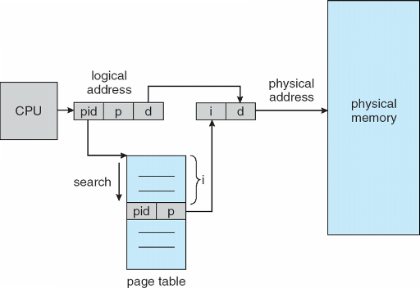
VPN
PPN
VPN
PPN
7
6
5
4
3
2
1
0
7
6
5
4
3
2
1
0
PPN
index
pid
VPN
5
4
3
2
1
0
2
2
Forward
Page Table
1
0
Inverted
Page Table
1
5
2
1
0
3
2
0
4
2
1
2
Process 1 (pid 1)
Page Table
Process 2 (pid 2)
Page Table
1
1
Forward
Page Table Lookup
Inverted
Page Table Lookup

Slide 28
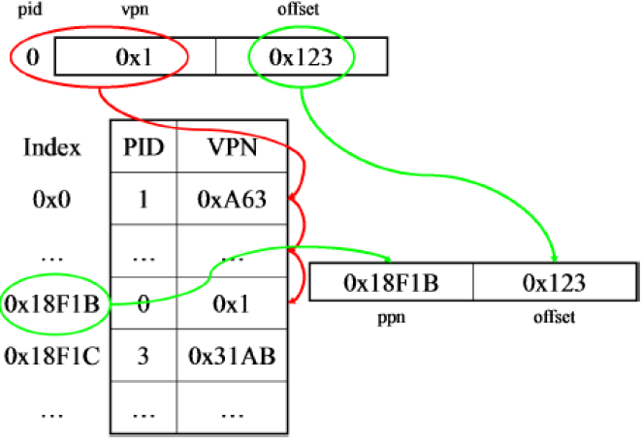
Inverted Page Table Lookup Example
pid=0, VPN=0x1 → PPN=0x18F1B
Inverted page table, EZCSE
https://www.youtube.com/watch?v=9pXnMfKq7Hw
Notes:
n computing, the prefix "0x" is used to denote that a number is written in the hexadecimal (base-16) number system.

Slide 29
Performance Implication of Paging
The issue of paging:
Page table stored in main memory
Fetch the translation from in-memory page table
Explicit load/store access on a memory address
Every data/instruction access incurs two memory accesses
One for the page table
and one for the data/instruction
Number of memory accesses is increased by a factor of 2!

Slide 30
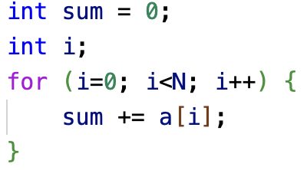
Memory Accesses of Paging
VPN | PPN
0 | 3
1 | 2
2 | 8
3 | 5
Physical memory
load 0x200C
load 0x5000
load 0x200C
load 0x5004
load 0x200C
load 0x5008
load 0x200C
load 0x500C
…
Page table stored
at memory
address 0x200C
Page size: 2¹²=4KB, hence offset is 12 bits. 16-bit virtual address space, hence VPN is 16-12=4 bits.
Suppose a[N] is an array of ints. Each int is 4 Bytes, hence Virtual Memory addresses in the for loop has stride of 4: 0x3000, 0x3004, 0x3008, etc. Suppose physical address space is also 16 bits (in practice it is smaller), hence PPN is also 4 bits, and page table maps VPN=3 to PPN=5. Suppose Page Table for all VPNs accessed by this program fit within one physical page at physical memory address 0x200C
Suppose the virtual page with VPN=3 has virtual memory address 0x3000, and the physical page with PPN=5 has physical memory address 0x5000
Each loop iteration incurs two memory accesses!
Virtual memory
load 0x3000
load 0x3004
load 0x3008
load 0x300C
…

Slide 31
Translation lookaside buffer (TLB)
TLB is a cache for entries in Page Table
Part of Memory Management Unit (MMU)
For historical reasons, called Translation Lookaside Buffer (TLB)
More accurate name is Page Table Address Cache; should be small enough to fit in CPU cache.
Maps from VPN to PPN (same as Page Table)
Memory reference with TLB
TLB hit: VPN is in cached in TLB, hence can get corresponding PPN w/o accessing Page Table
TLB miss: VPN is not in TLB. Access Page Table to get the translation to PPN, update the TLB entry with the translation
Virtual
Address
TLB
Physical
Memory
CPU
Physical
Address
Cached?
Yes
No
Save
Result
Page Table
Or, directly access
physical memory address
w/o translation
Notes:
To speed up the paging translation, hardware helps and builds a cache to store some popular translations
Looks up Virtual Address; returns Physical Address
A typical TLB entry: VPN | PFN | other bits (Valid bit, Protection bit, Dirty bit)
Translation lookaside buffer (TLB)
Part of Memory-management unit (MMU)
Hardware Cache

Slide 32
TLB is a Type of Cache
TLB stores page table entries at Page Number granularity (not including the Byte Offset within a page), and each page is large (e.g., 4KB).
Cache stores actual memory contents (instruction or data) at memory address granularity (including the Byte offset within a cache block).
Hence TLB can be effective at a very small size (e.g.128-512 entries), and can fit within cache (L1 or L2) for fast access without touching memory.
Data at memory address
Virtual Page Number
Physical Page Number
Memory Address
Cache
TLB
On miss: Access next cache level / main memory
On miss: Access Page Table in memory
Notes:
Virtual-to-Physical memory address mapping

Slide 33
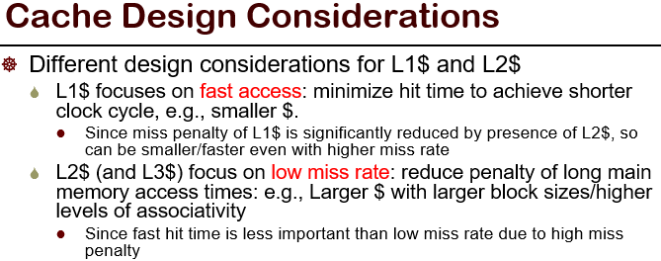
TLB Organization
TLB is usually fully-associative, but can also be set-associative
Since miss penalty is high (one memory access, similar to Last-Level Cache), FA or high associativity SA is adopted to minimize miss rate at the cost of slightly increased hit time. (Recall “Cache Design Considerations”.)
With FA, there is no set index bit, and the tag bits are the VPN. Any VPN entry can be anywhere in the TLB, and hardware searches entire TLB in parallel to find a tag match.
TLB is write-through (not write-back)
Always keep TLB and Page Table consistent
(wait until after lecture on cache to understand it)
virtual address
VPN offset
V R W X tag PPN
(VPN = Virtual Page Number)
(PPN = Physical Page Number)
hit?
physical address
PPN offset
Notes:
Split into T, I, O! Similar to L2/L3 cache design.

Slide 34
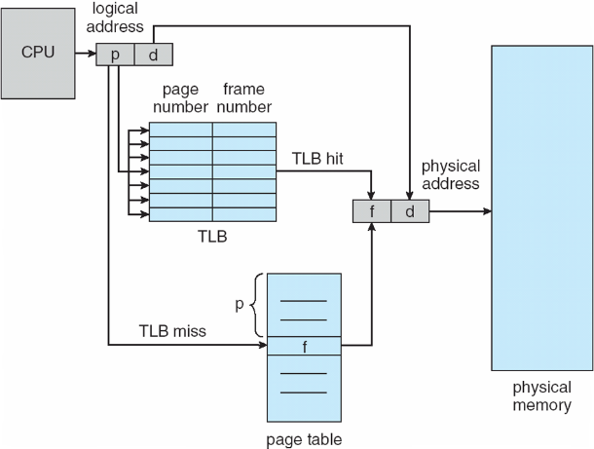
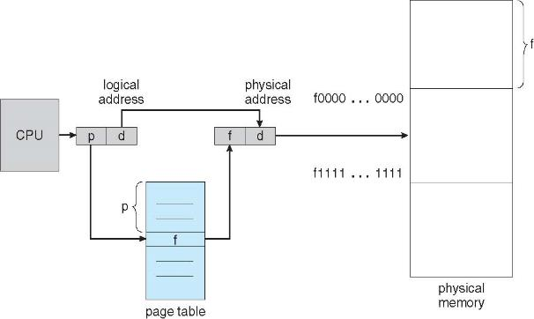
Page Table Lookup w/ vs. w/o TLB
Page Table Lookup
without TLB
Page Table Lookup
with TLB

Slide 35
TLB Example
VPN | PFN
0 | 3
1 | 2
2 | 8
3 | 5
Virtual memory
load 0x3000
load 0x3004
load 0x3008
load 0x300C
…
Physical memory
Page table
TLB Cache
Valid | VPN | PFN
0
0
0

Slide 36
TLB Example
VPN | PFN
0 | 3
1 | 2
2 | 8
3 | 5
Virtual memory
load 0x3000
load 0x3004
load 0x3008
load 0x300C
…
Physical memory
Page table
TLB Cache
Valid | VPN | PFN
0
0
0
MISS!!

Slide 37
TLB Example
VPN | PFN
0 | 3
1 | 2
2 | 8
3 | 5
Virtual memory
load 0x3000
load 0x3004
load 0x3008
load 0x300C
…
Physical memory
load 0x200C
load 0x5000
Page table
TLB Cache
Valid | VPN | PFN
1 | 3 | 5
0
0
Update TLB

Slide 38
Table Lookaside Buffer (TLB)
VPN | PFN
0 | 3
1 | 2
2 | 8
3 | 5
Virtual memory
load 0x3000
load 0x3004
load 0x3008
load 0x300C
…
Physical memory
load 0x200C
load 0x5000
load 0x5004
Page table
TLB Cache
Valid | VPN | PFN
1 | 3 | 5
0
0
TLB hit

Slide 39
TLB Example
VPN | PFN
0 | 3
1 | 2
2 | 8
3 | 5
Virtual memory
load 0x3000
load 0x3004
load 0x3008
load 0x300C
…
Physical memory
load 0x200C
load 0x5000
load 0x5004
load 0x5008
Page table
TLB Cache
Valid | VPN | PFN
1 | 3 | 5
0
0
TLB hit

Slide 40
TLB Example
VPN | PFN
0 | 3
1 | 2
2 | 8
3 | 5
Virtual memory
load 0x3000
load 0x3004
load 0x3008
load 0x300C
…
load 0x2000
Physical memory
load 0x200C
load 0x5000
load 0x5004
load 0x5008
load 0x500C
…
load 0x8000
Page table
TLB Cache
Valid | VPN | PPN
1 | 3 | 5
1 | 2 | 8
0
Miss!!

Slide 41
Effective Access Time with TLB
TLB lookup time = σ time unit
Memory access time = m time unit
Assume: Page table needs single access (no multilevel page tables)
There is no cache
TLB Hit Rate = η
Effective access time:
EAT = Hit Time * Hit Rate + Miss Time * Miss Rate
= (m + σ) η + (2m + σ)(1 – η) = 2m + σ – m η

Slide 42
Valid & Dirty Bits
TLB entries have valid bits and dirty bits. Data cache blocks have them also.
The valid bit means the same in both: valid = 0 means either TLB miss or cache miss.
The dirty bit has different meanings. For cache, it means the cache block has been changed. For TLBs, it means that the page corresponding to this TLB entry has been changed.

Slide 43
Demand Paging
Modern programs require a lot of physical memory
Memory per system growing faster than 25%-30%/year
But they don’t use all their memory all of the time
90-10 rule: programs spend 90% of their time in 10% of their code
Wasteful to require all of user’s code to be in memory
Solution: use main memory as “cache” for disk
Demand paging: If a requested page is not found in page table, then page fault occurs, OS brings the requested page in from secondary storage to memory
Processor
caching
paging
Control
Tertiary
Storage
(Tape)
Second
Level
Cache
(SRAM)
Main
Memory
(DRAM)
Secondary
Storage
(Disk)
Datapath
On-Chip
Cache
43
Notes:
The Virtual-to-Physical Translation fails
PTE marked invalid, Priv. Level Violation, Access violation, or does not exist
Causes an Fault / Trap
Not an interrupt because synchronous to instruction execution
May occur on instruction fetch or data access
Other Page Faults engage operating system to fix the situation and retry the instruction
Allocate an additional stack page, or
Make the page accessible - Copy on Write,
Bring page in from secondary storage to memory – demand paging
Fundamental inversion of the hardware / software boundary

Slide 44
Summary
Translation Lookaside Buffer (TLB)
Small number of PTEs and process IDs (< 512)
Often Fully Associative (Since conflict misses expensive)
On TLB miss, page table must be traversed and if located PTE is invalid, cause Page Fault
On change in page table, TLB entries must be invalidated
Demand Paging: Treating the DRAM as a cache on disk
Page table tracks which pages are in memory
Any attempt to access a page that is not in memory generates a page fault, which causes OS to bring missing page into memory
Replacement policies
FIFO: Place pages on queue, replace page at end
MIN: Replace page that will be used farthest in future
LRU: Replace page used farthest in past
Notes:
optional

Slide 45
Outlines
Table Lookaside Buffer (TLB)
Multi-level TLB
Inverted page table
Page swapping
Page replacement policy

Slide 46
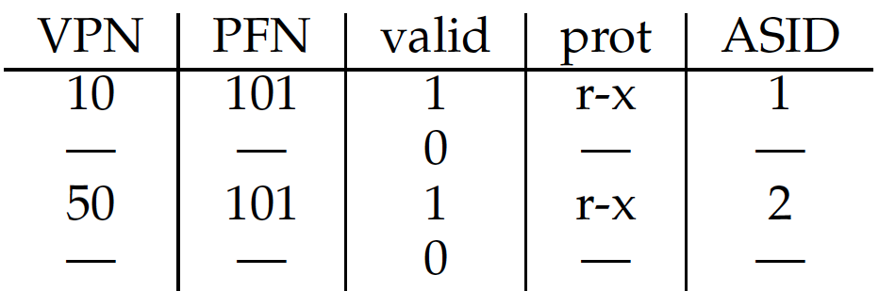
TLB Issue: Context Switch
Each process has its own page table and virtual address space; But there is only a single TLB in the system
TLB entries no longer valid upon process context-switch
Solution 1: Flush
Invalidate TLB by setting valid bits of all TLB entries to 0
Simple but expensive for frequent context switching between processes
Solution 2: Address space identifier (ASID)
Hardware provides an address space identifier (ASID) field in the TLB (Think of ASID as process ID (pid)), to distinguish which process a TLB entry belongs to
Notes:
Options:
Include Process ID in TLB
Needs hardware support
OS flushes the whole TLB on context switch
Flush operation sets all valid bit to 0
Problem: verhead is too high if OS switches processes too frequently
8 bits for asid 256 unique values
32 bits for pid
How to distinguish which process a TLB entry belongs to
Process 1: VPN 10 -> PFN 100
Process 2: VPN 10 -> PFN 170
TLB contains translations only valid for current running process
Switching from one process to another requires OS or hardware to do more work

Slide 47
Problems of Paging
Page table is too big
A linear page table array for 32-bit address space (2³² bytes) and 4KB page (2¹² bytes)
How many pages: 2²⁰ pages
How much memory: 4MB assuming each page-table entry is of 4 bytes
2 ^ (32-log(4KB)) * 4 = 4MB
One page table for one process:
100 processes: 400MB

Slide 48
Smaller Page Table
Naïve solution:
Bigger page size -> smaller page table
32-bit address space: 4KB page size -> 16KB
We can reduce the size by 4x to 1MB per page table
Page size: 2^{X}, 4KB – 1GB
getconf PAGESIZE (MacOS and Linux)
16KB for MacOS
Problem: Internal fragment
Do not use up the whole page
Notes:
In the worst case, needs k pages + 1 byte

Slide 49
Variable Page Size
TLB has limited size
16-512
Multiple-level implementation, like cache
Smaller page size → more TLB entries
A process of 64KB, 4KB page size
16 TLB entries
1MB page size
1 TLB entry
Variable page size:
This depends on hardware and OS
Windows 10 supports 4KB and 2MB
Linux has default page size (4KB) and huge page
Notes:
You manage fewer pages
Operating systems try to make best use of limited number of TLB resources. This optimization is more critical now as bigger and bigger physical memories (several GBs) are more readily available.

Slide 50
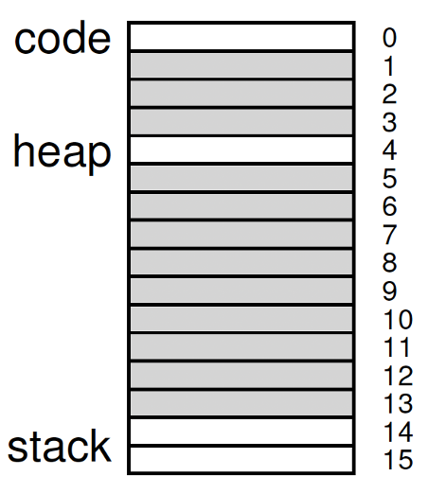
Multi-Level Paging
Large page table is contiguous and may have some unused pages
Allocate page table in a non-contiguous manner
Break the page table into pages, i.e., page the page tables
Create multiple levels of page tables; outer level “page directory”
Page directory to track whether a page of the page table is valid
If an entire page of page table entries is invalid, no allocation

Slide 51
Multi-Level Paging
Linear Page Table
PBTR
201
Multi-level Page Table
prot
PBTR
200
valid
1 | rx | 12
1 | rx | 13
0 | - | -
1 | rw | 100
0 | - | -
0 | - | -
0 | - | -
0 | - | -
0 | - | -
0 | - | -
0 | - | -
0 | - | -
PFN
valid
valid
prot
PFN
PFN201
PFN
1 | 201
0 | -
0 | -
1 | 203
1 | rx | 12
1 | rx | 13
0 | - | -
1 | rw | 100
PFN200
PFN201
PFN202
The Page Directory
[Page 2 of PT:Not Allocated]
PFN203
[Page 3 of PT: Not Allocated]
Only allocates page-table space in proportion to the amount of address
space you are using
0 | - | -
0 | - | -
1 | rw | 86
1 | rw | 15
0 | - | -
0 | - | -
1 | rw | 86
1 | rw | 15
PFN204
PFN204

Slide 52
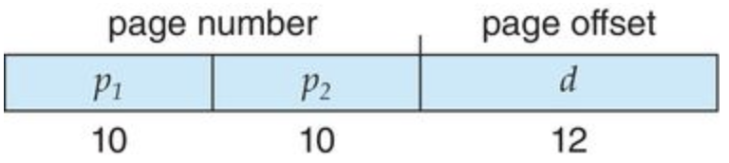
Multi-Level Paging
A virtual address of 32-bit with 4KB page size is divided into
a page number consisting of 20 bits
a page offset consisting of 12 bits
A page table entry is 4 bytes
Since the page table is paged, the page number is further divided into
where p₁ is an index into the page directory, and p₂ is the page table index
Notes:
Page table index page of page table

Slide 53
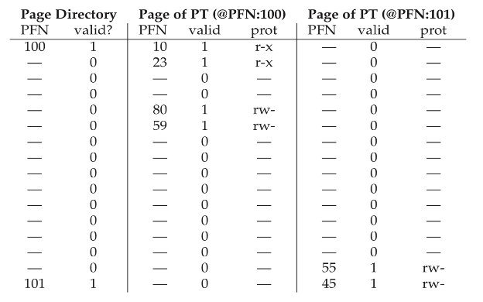
Multi-Level Paging
16KB address space, 14 bit address
64-byte (2^6) page size
Page table entry 4 bytes
code
PFN: 10
PFN: 23
heap
PFN: 80
PFN: 59
stack
PFN: 55
Single level paging: 16 pages→ Two level paging: 3 pages
PFN: 45
Notes:
64=2^6

Slide 54
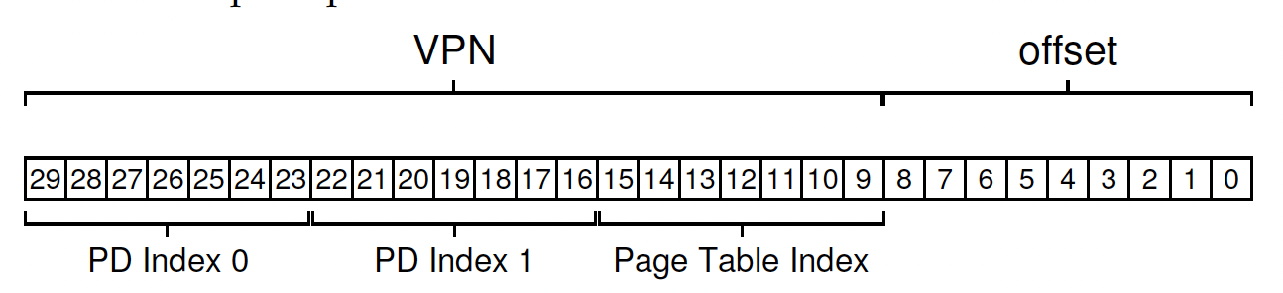
Multi-Level Paging
Problem with 2 levels: page directories may not fit in a page
Split page directories into pieces
Multi-level page directories and each one can fit in a page
30-bit address space, 512-byte page size, 4byte PTE
Notes:
512 2^9

Slide 55
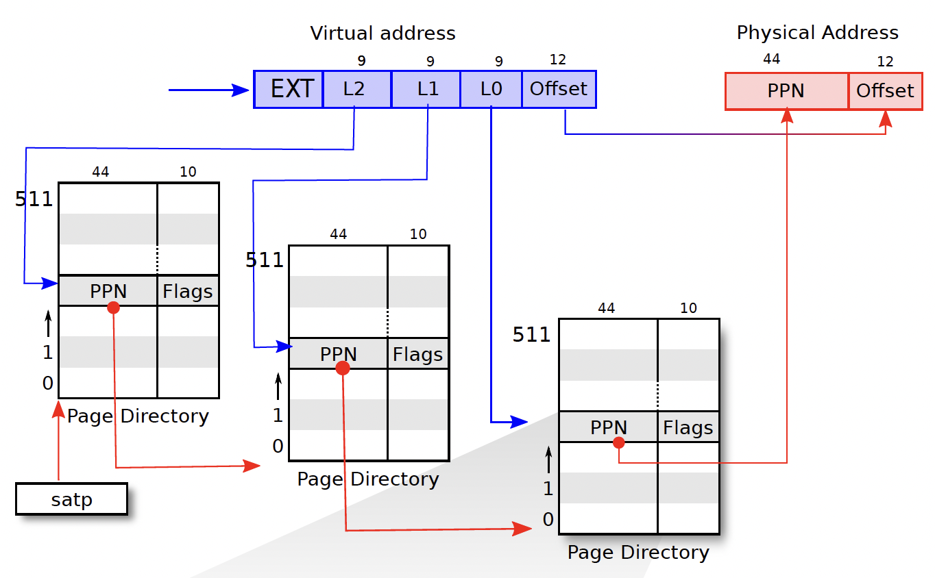
Multi-Level Paging
XV6-Sv39 - 3 level
XV6-Sv48 – 4 level

Slide 56
Page Swapping
Motivation
Processes spend majority of time in small portion of code
The 90/10 rule: approximately 90% of time in 10 % of code
Process only uses small amount of address space (pages) at any moment
Only small amount of address space (pages) need to be resident in physical memory
Hardware:
Memory: fast, but small, 2-100 GB/s
Disk: slow, but large, 80-160 MB/s (HDD) 500MB/s (SSD)
Idea:
Process can run with only some of its pages in memory
Only keep the actively used pages in memory
Keep unreferenced pages on disk
Notes:
Solid state disk 500MB/s
Large virtual memory can be provided on a smaller physical memory

Slide 57
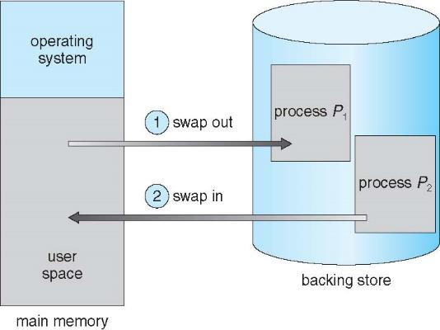
Page Swapping
Swapping makes it possible for the total physical address space of all processes to exceed the real physical memory of the system
Swapping Space

Slide 58
Page Swapping
Reserve some space on the disk for moving pages back and forth —— Swap space
OS keeps track of the swap space, in page-sized unit.
PFN 0
PFN 1
PFN 2
PFN 3
Proc 0 [VPN 0] | Proc 1 [VPN 2] | Proc 1 [VPN 3] | Proc 2 [VPN 0]
Physical
Memory
Block 1
Block 2
Block 3
Block 4
Block 5
Block 6
Block 0
Block 7
Swap
Space
Proc 0 [VPN 1] | Proc 0 [VPN 2] | [Free] | Proc 1 [VPN 0] | Proc 1 [VPN 1] | Proc 3 [VPN 0] | Proc 2 [VPN 1] | Proc 3 [VPN 1]
Physical Memory and Swap Space

Slide 59
Page Swapping
How to know where a page lives?
Present bit/Valid bit
1 indicates in-memory
0 indicates in-disk
X86 page table entry (PTE)
Page fault: if present bit in PTE is 0, when accessing a page
31 | 30 | 29 | 28 | 27 | 26 | 25 | 24 | 23 | 22 | 21 | 20 | 19 | 18 | 17 | 16 | 15 | 14 | 13 | 12 | 11 | 10 | 9 | 8 | 7 | 6 | 5 | 4 | 3 | 2 | 1 | 0
PFN
G
PAT
D
A
PCD
PWT
U/S
R/W
P

Slide 60
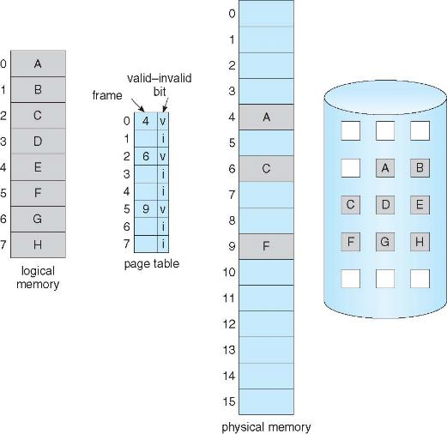
Page Swapping

Slide 61
Page Swapping Policies
The objective of page swapping policies: to minimize the number of page faults (cache misses)
Two decisions:
Page selection
When should a page on disk be brought into memory?
Page replacement
Which in-memory page should be evicted to disk?

Slide 62
Page Selection
Demand paging:
Load page only when it is needed (demand)
Less I/O, less memory
Problems: High page fault cost
Prefetch:
Load page before referenced
OS predicts future accessed pages (oracle) and brings them into memory early
Works well for some access patterns, like sequential pages
Notes:
Demand paging, lazy pages

Slide 63
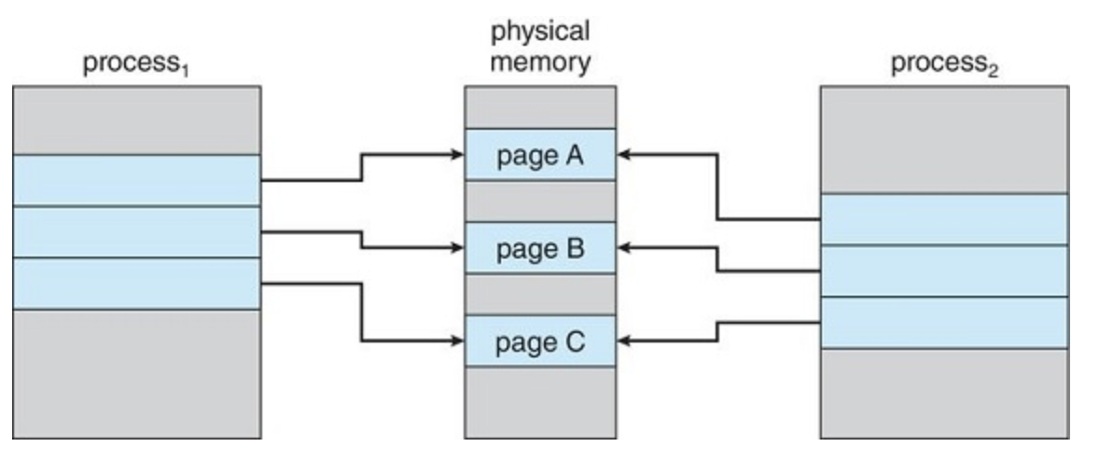
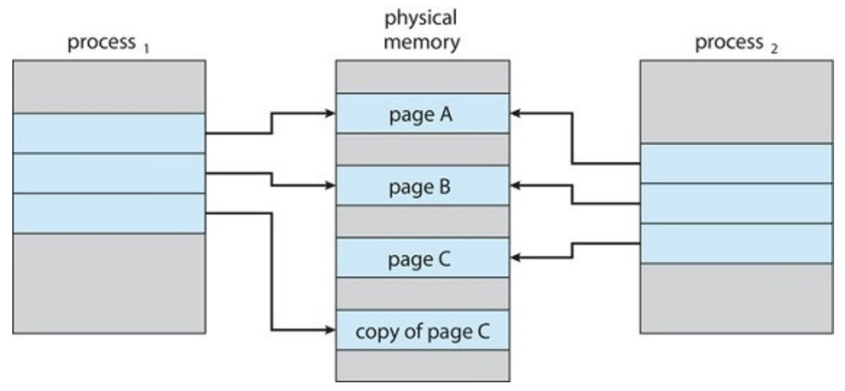
Copy-On-Write Paging
Copy the page only if a process writes to it (demand)
Process creation fork() + exec()

Slide 64
Page Replacement
When does page replacement happen?
Lazy approach
If memory is entirely full, OS then replaces a page to make room for some other page.
This is unrealistic.
The OS usually needs to reserve some room for the new pages
Swap Daemon, Page Daemon
There are fewer than LW (low watermark) pages available, a background thread that is responsible for freeing memory is activated.
The thread evicts pages until there are HW (high watermark) pages available.

Slide 65
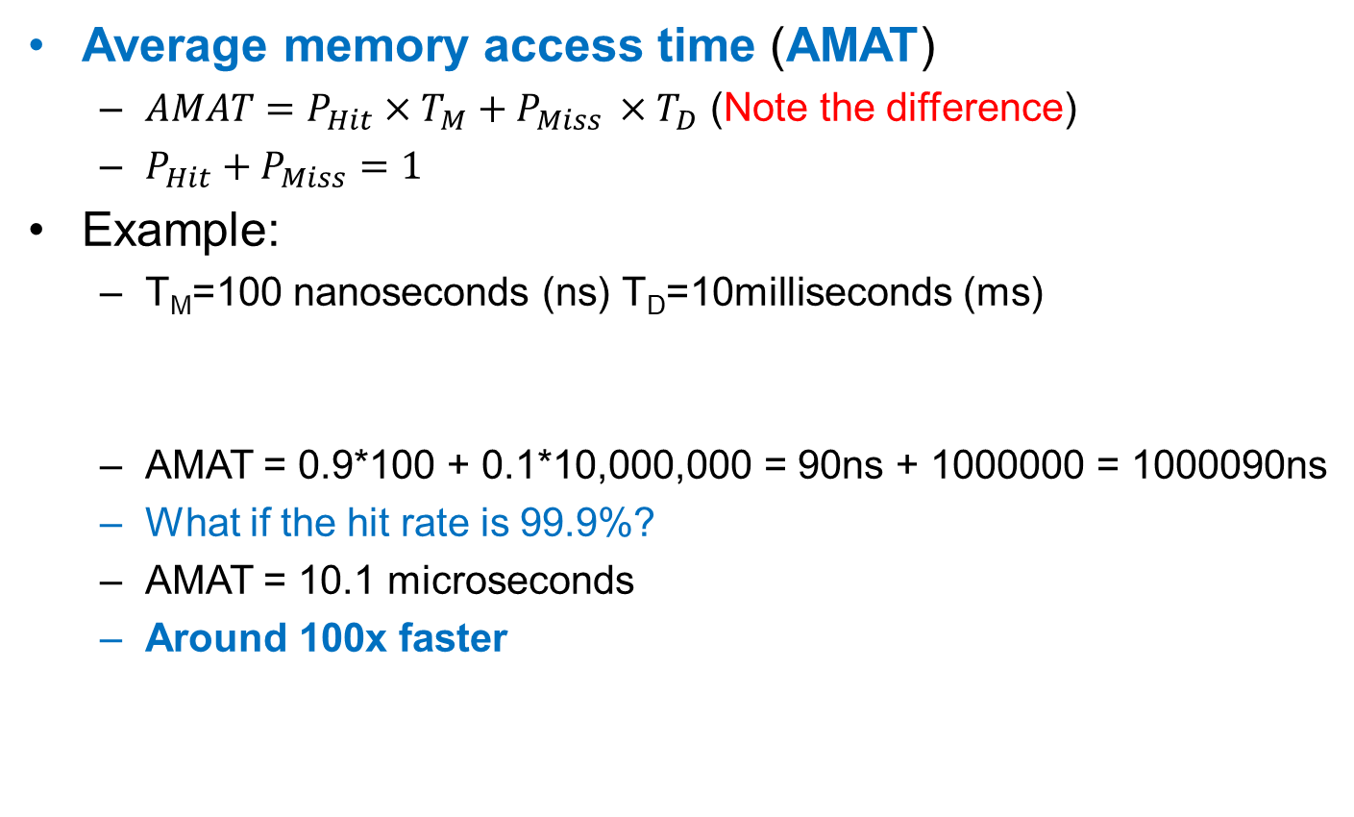
Page Replacement Policies
Average memory access time (AMAT)
$AMAT={P_{Hit}×T}_{M}+P_{Miss }×T_{D}$ (Note the difference)
$P_{Hit}+P_{Miss}=1$
Example:
T_{M}=100 nanoseconds (ns) T_{D}=10milliseconds (ms)
AMAT = 0.9*100 + 0.1*10,000,000 = 90ns + 1000000 = 1000090ns
What if the hit rate is 99.9%?
AMAT = 10.1 microseconds
Around 100x faster
H | H | H | M | H | H | H | H | H | H

Slide 66
Page Replacement Policies
Optimal replacement:
Replace the page that will not be used for the longest time in future
Pros: Minimal number of page faults
Cons: impractical, need to predict the future.
Can be used as a comparison baseline
FIFO:
Replace the oldest page, that was loaded into memory first
Pros: Fair, easy to implement
Cons: May evict useful pages
Least-recently-used (LRU): (Predict using history)
Replace the page which has not been used for longest time
Pros: Approximate optimal replacement
Cons: Difficult to implement
Notes:
Not recently used (NRU)
Use the referenced and modified bits in the page table entries. 4 possibilities:
Not referenced, not modified
Not referenced, modified (reference cleared on clock interrupt)
Referenced, not modified
Referenced, modified
When a page fault occurs, find any page in group 1, failing that any page in group 2, failing that any page in group 3, failing that any page in group 4. If there is more than one page in the lowest group, randomly choose one page from the group.
Rationale: replace the page that has not been referenced or modified.
Optimal (OPT)
Not recently used (NRU)
First-In, First-Out (FIFO)
Second chance (SC)
Least recently used (LRU)
Not frequently used (NFU)
Aging algorithm
Clock algorithm
Working set
WSClock
Replace page that won’t be used for the longest time
Optimal, but infeasible in practice, since can’t really know future…
Makes good comparison case, however

Slide 67
Example: FIFO
Consider cache size of 3 pages, and following reference stream of virtual pages:
A B C A B D A D B C B
FIFO page replacement policy incurs 7 page faults:
When referencing D, replacing A is bad choice, since need A again right away
Ref:
Page:
A
B
C
A
B
D
A
D
B
C
B
1
A
D
C
2
B
A
3
C
B

Slide 68
Example: OPT & LRU
Consider cache size of 3 pages, and following reference stream of virtual pages:
A B C A B D A D B C B
OPT page replacement policy incurs 5 page faults:
Where will D be placed? Look for the page not referenced farthest in future (C)
LRU page replacement policy makes the same decisions as OPT in this case
but not always true!
Ref:
Page:
A
B
C
A
B
D
A
D
B
C
B
1
A
C
2
B
3
C
D

Slide 69
When will LRU perform badly?
Consider cache size of 3 pages, and following reference stream of virtual pages:
A B C D A B C D A B C D
Cyclically referencing 4 memory pages
LRU page replacement policy incurs a page fault for every page reference!
Ref:
Page:
A
B
C
D
A
B
C
D
A
B
C
D
1
A
D
C
B
2
B
A
D
C
3
C
B
A
D

Slide 70
OPT performs better, but it’s not implementable
Ref:
Page:
A
B
C
D
A
B
C
D
A
B
C
D
1
A
B
2
B
C
3
C
D
Notes:
OPT Does much better

Slide 71
Another example (cache size of 3 pages)
FIFO: 6 misses
OPT: 4 misses
LRU: 5 misses
A | A
A | A
B | A | B
B | A | B
C | A | B | C
D | D | B | C
B | D | B | C
A | D | A | C
B | D | A | B
A | D | A | B
A | A
A | A
B | A | B
B | A | B
C | A | B | C
D | A | B | D
B | A | B | D
A | A | B | D
B | A | B | D
A | A | B | D
A | A
A | A
B | A | B
B | A | B
C | A | B | C
D | D | B | C
B | D | B | C
A | D | B | A
B | D | B | A
A | D | B | A

Slide 72
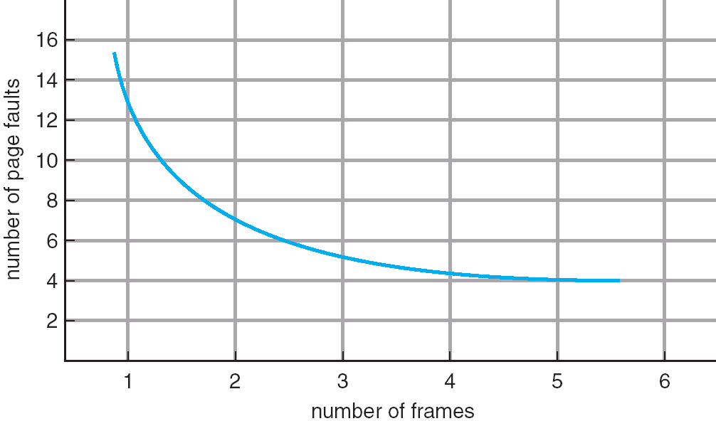
Page faults vs. cache size
When you increase cache size (number of frames), number of page faults should go down
Yes for LRU and OPT
Not always for FIFO (Called Belady’s anomaly)
Notes:
FIFO does not have this property

Slide 73
BeLady’s anomaly
After increasing cache size from 3 pages to 4 pages, for the given reference stream:
With FIFO, number of page faults increases from 9 to 10!
With LRU or OPT, cache contents with size of X pages are a subset of contents with size of X+1 Pages. Whereas for FIFO, cache contents can be completely different
Ref:
Page:
A
B
C
D
A
B
E
A
B
C
D
E
1
A
D
E
FIFO: 9 page faults
2
B
A
C
3
C
B
D
Ref:
Page:
A
B
C
D
A
B
E
A
B
C
D
E
1
A
E
D
FIFO: 10 page faults
2
B
A
E
3
C
B
4
D
C
Notes:
Does adding memory reduce number of page faults?
With FIFO, cache contents can be completely different
Does adding memory reduce number of page faults?
Yes for LRU and OPT
Not necessarily for FIFO! (Called Belady’s anomaly)
After adding memory:
With FIFO, contents can be completely different
In contrast, with LRU or OPT, contents of memory with X pages are a subset of contents with X+1 Page
In contrast,

Slide 74
Page Replacement Policies
Other policies:
Random (RAND), Least-frequently used (LFU)
The performance of replacement policies also depends on workloads.
Random workload: LRU, RAND, and FIFO no difference
80-20 workload: LRU is better than RAND and FIFO
Looping sequential workload: RAND is better than LRU and FIFO
Notes:
loop sequential 50 pages and repeat the 50 pages access
80 percent of references go to 20 percent of pages
What happens to performance, if adding more physical memory
LRU and RAND have fewer or same number of page faults
FIFO usually has fewer page faults, but Belady’s anomaly -> more page faults
Sequence: ABCDABEABCDE
3 frames vs. 4 frames
9 misses vs. 10 misses

Slide 75
Putting Everything Together: Address Translation
Physical
Memory:
Virtual Address:
Virtual
P1 index
Virtual
P2 index
Offset
PageTablePtr
Physical Address:
Physical
Page #
Offset
Page Table
(1st level)
Page Table
(2nd level)
75

Slide 76
Putting Everything Together: TLB
Physical
Memory:
Virtual Address:
Virtual
P1 index
Virtual
P2 index
Offset
PageTablePtr
Physical Address:
Physical
Page #
Physical
Page #
Offset
Page Table
(1st level)
Page Table
(2nd level)
TLB:
…
76

Slide 77
Putting Everything Together: TLB+Cache
Physical
Memory:
Virtual Address:
Virtual
P1 index
Virtual
P2 index
Offset
PageTablePtr
Physical Address:
Physical
Page #
Offset
Page Table
(1st level)
tag
index
byte
cache:
Page Table
(2nd level)
tag:
block:
TLB:
…
…
77

Slide 78
Summary
Paging: flexible virtual memory management
Challenges with paging
Slow access
Big page table and high memory consumption
Table Lookaside Buffer (TLB) for slow access
Multi-level paging and inverted page tables for big page table
Larger address space: swapping and replacement
Notes:
Scheduler is an important topic in OS
CFS 17,900 lines of code

Slide 79
References
Memory Management (Virtual Memory / Paging / DMA), BitLemon
https://www.youtube.com/playlist?list=PL38NNHQLqJqZoDp4CrAueD1aBin7OebEL
Lectures on Virtual Memory, by David Black-Schaffer
https://www.youtube.com/playlist?list=PLiwt1iVUib9s2Uo5BeYmwkDFUh70fJPxX
Inverted page table, EZCSE
https://www.youtube.com/watch?v=9pXnMfKq7Hw
Notes:
Consider a cache size of 3 page frames, and following reference stream of virtual pages:
7 0 1 2 0 3 0 4 2 3 0 3 2 1 2 0 1 7 0 1
Run FIFO, OPT and LRU on this example.
Answer:
FIFO: http://cs.uttyler.edu/Faculty/Rainwater/COSC3355/Animations/fifopagereplacement.htm
OPT: http://cs.uttyler.edu/Faculty/Rainwater/COSC3355/Animations/optimalpagereplacement.htm
LRU: http://cs.uttyler.edu/Faculty/Rainwater/COSC3355/Animations/lrupagereplacement.htm

